Slide 1
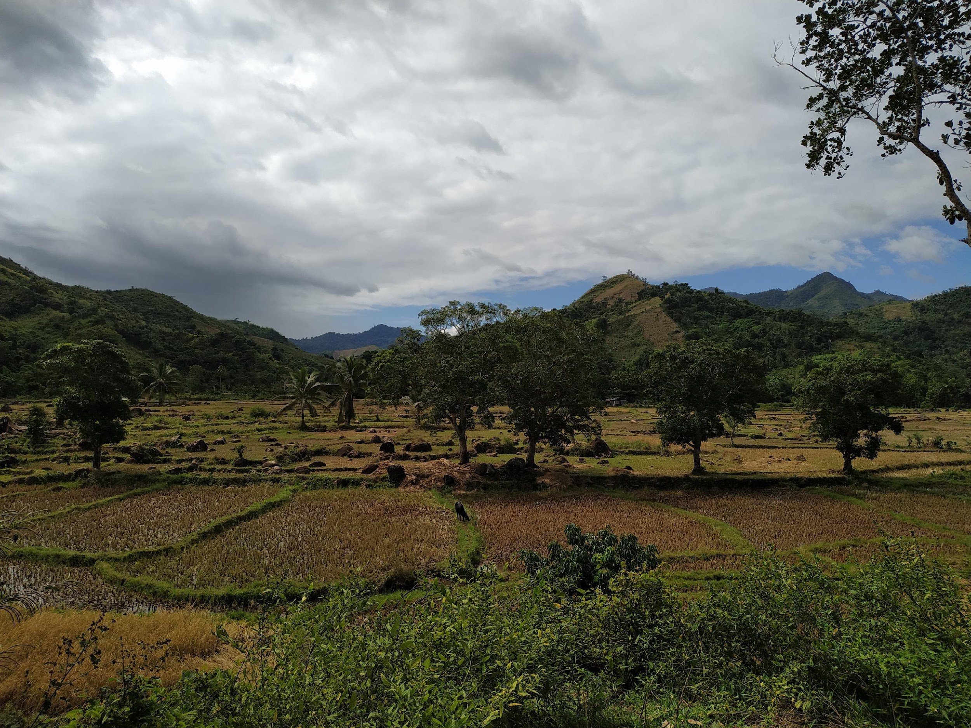
Distinct drivers of host-microbe network structures for core and rare microbes along a land use change gradient
Matan Markfeld, Georgia Titcomb, Charles Nunn, Shai Pilosof
September 2024

Slide 2
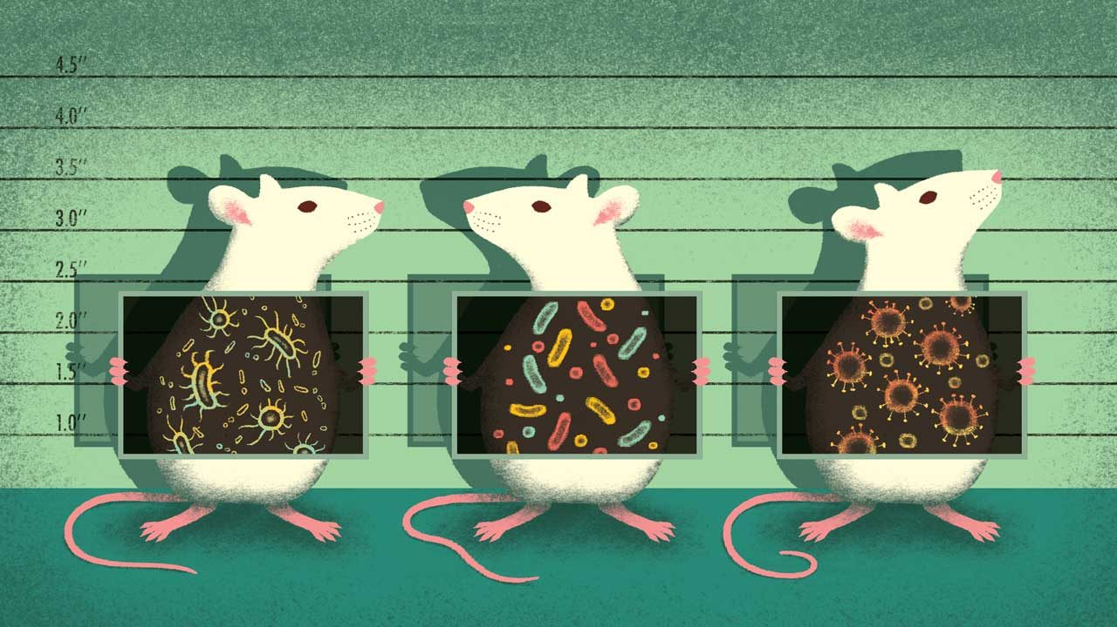
The microbiome is crucial for host health and function
It is important to understand the processes and factors that shape the microbiome
Berg et. al., 2020; Rosenberg & Zilber-Rosenberg, 2018
Notes:
the microbiome is crucial for the host health and function. Changes to the microbiome might change the host’s function and make it more susceptible to disease, for example.
Affecting disease.. specifically in rodents that are an important reservoir of zoonotic disease agents.
Therefore, it is important to understand the processes and factors that shape the microbiome.

Slide 3
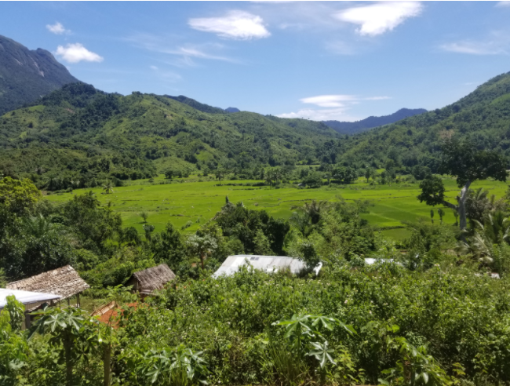
Land use change
Forest
Agriculture
Host community change
Human-Wildlife interface
Village
Diet shift
Host Microbiome
Newbold et. al., 2015; Bernardo-Carvo et. al., 2020; Fackelmann et. al., 2021
Notes:
Additionally, Human-wildlife interface is changed with agricultural practices. This can lead to diet shift of the host and to changes in the gut conditions.
and of course, that also can expose animals to human microbes and pathogens.

Slide 4
Land use change
Forest
Agriculture
Host community change
Human-Wildlife interface
Village
Diet shift
Neutral processes
Host Microbiome
Selective processes

Slide 5
Core and non-core microbiome
Functional roles may vary between microbial groups
Different processes at different scales may drive the distribution of different groups of microbes

Slide 6

While most microbiome research focuses on humans or domestic animals, we still don’t know a lot about wild animals and how environmental factors, such as land use change, affect their microbiome
Assessing the effect of land use change on the microbial community is challenging, as the landscape is continuous and not discrete, presenting high heterogeneity within each land use and across land uses
Notes:
However, while most moicrobiome research focuses on humans or domestic animals, we still don’t know a lot about wild animals and how environmental factors, such as land use change, affect their microbiome.

Slide 7
We can explore the host-microbe network structure
The network’s structure is a signature of the processes that shaped the network
The network captures the heterogeneity within and between land uses
Microbes
Hosts
Agroforest
Rice
Forest

Slide 8
Research questions
Q1. What processes shape host-microbe community structures along a land use change gradient?
Q2. How do core and rare microbial groups differ in these processes?

Slide 9
Hypotheses
H1. Neutral processes
H2. Processes at the local scale (within land use)
H3. Processes at the land use scale
H4. Interaction between microbial group and H1-3

Slide 10
Filtering the microbiome
Rattus from 3 villages
Feces – gut microbiome
Bacteria ASVs
Relative reads abundance > 0.1% per sample
Prevalence > 1%
Total reads in a sample > 5000
Taxonomy

Slide 11
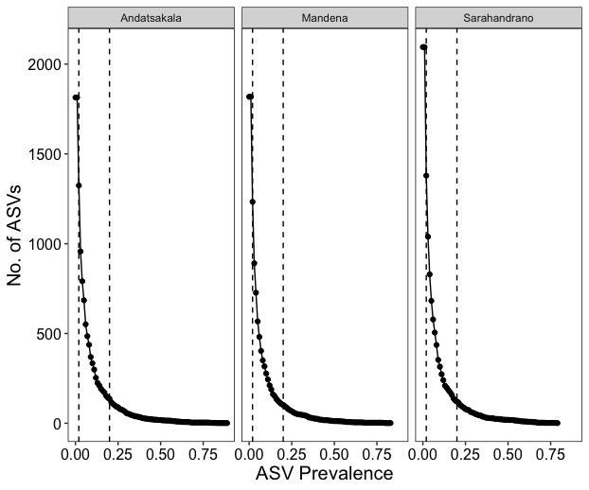
Microbes' prevalence
3 groups:
Rare [1%-2%]
Non-core [2%-20%]
Core [>20%]

Slide 12
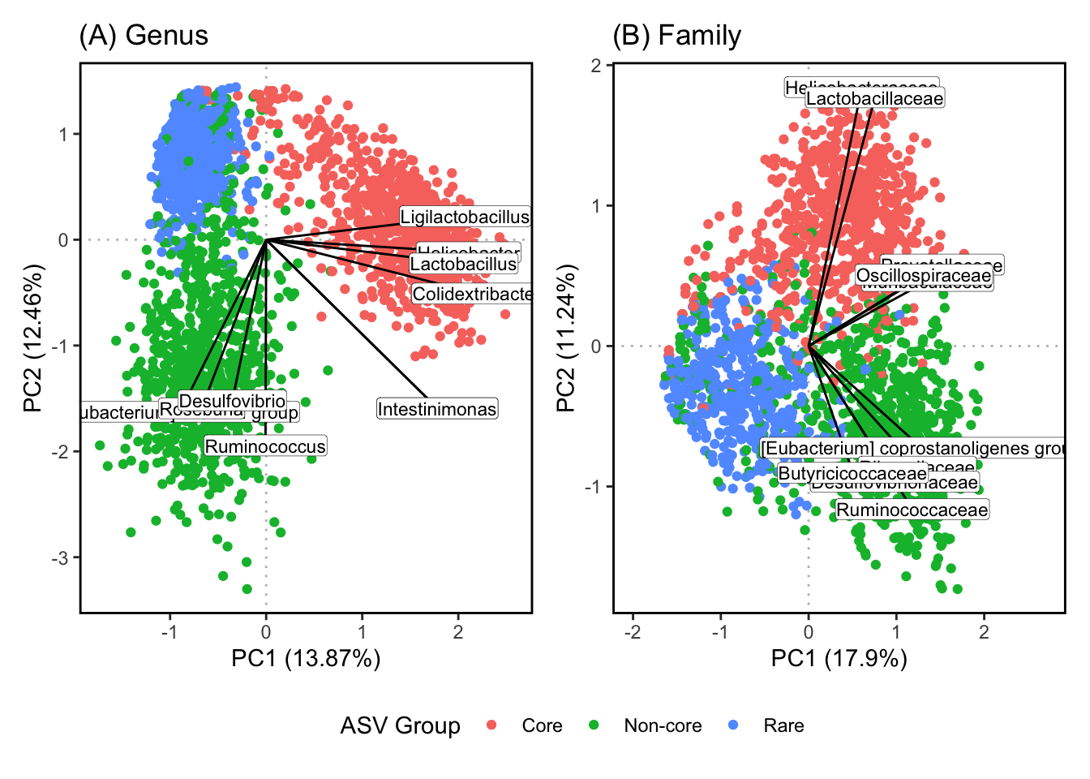
The groups represent different microbial genera (and potentially functions)

Slide 13
Bipartite network between host individuals and bacteria ASVs
Link’s weight = ASV relative abundance
Infomap
Microbes
Hosts
Agroforest
Rice
Forest

Slide 14
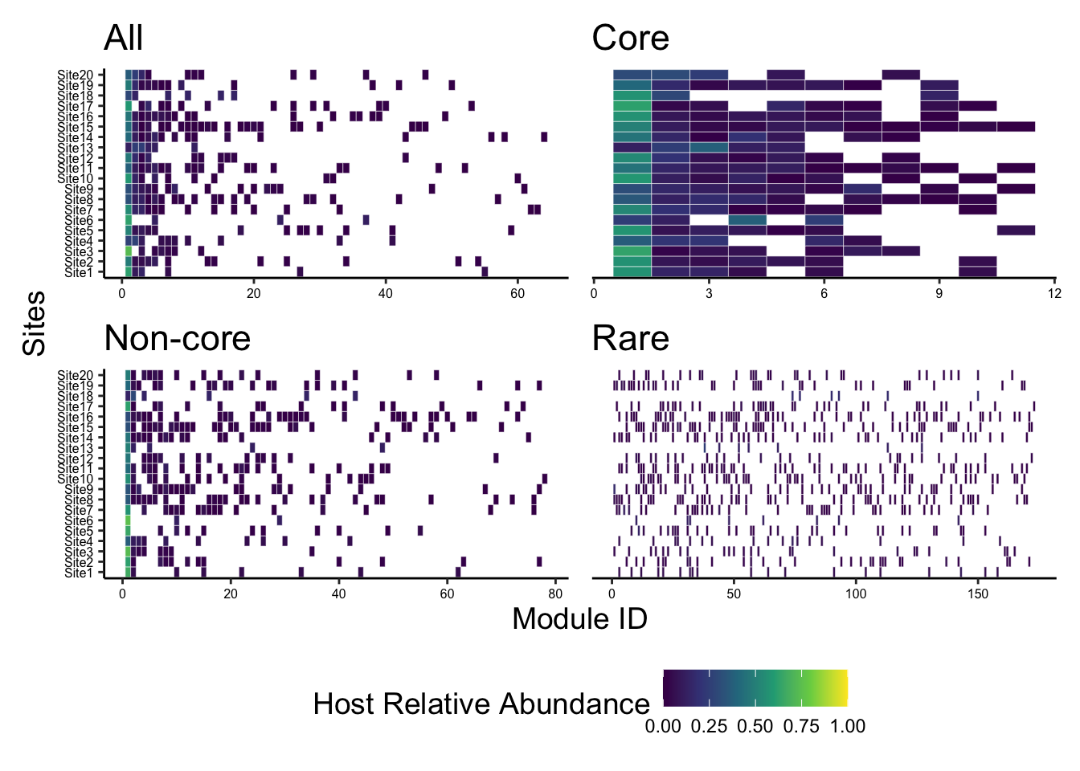
Community detection - Infomap

Slide 15
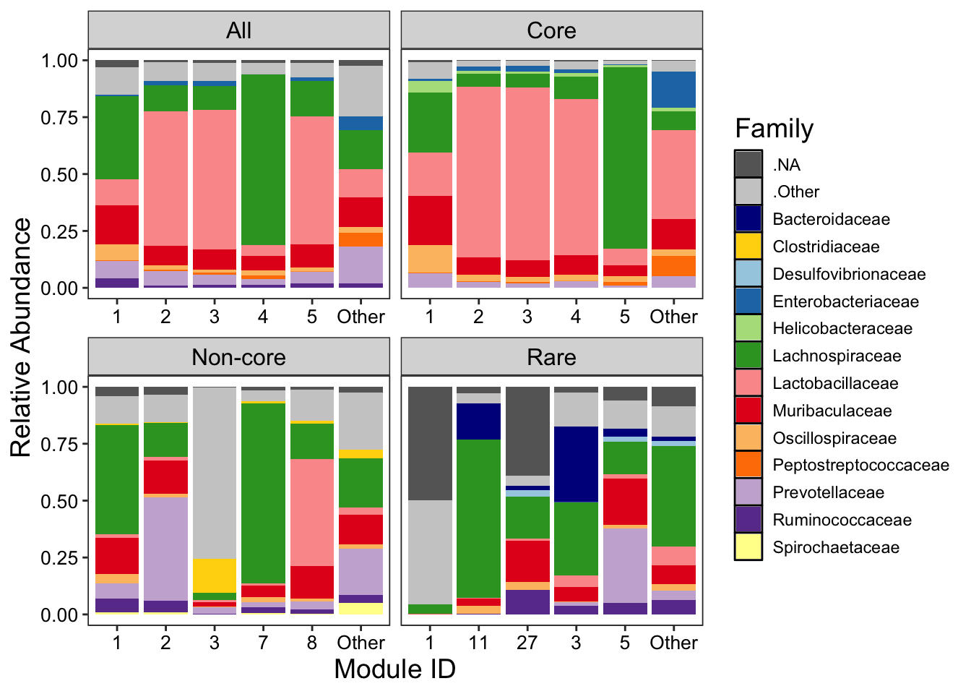
Family relative abundance

Slide 16
What does this modular structure tell us about the processes that shaped the network?
Beta-NTI (Nearest Taxon Index)
Measures phylogenetic turnover compared to the turnover expected by chance
Raup-Crick
Measures turnover compared to the turnover expected by chance
Stegen et. al., 2012; Zhou & Ning, 2017
Notes:
To answer my question we need first to connect between the structure and the processes.

Slide 17
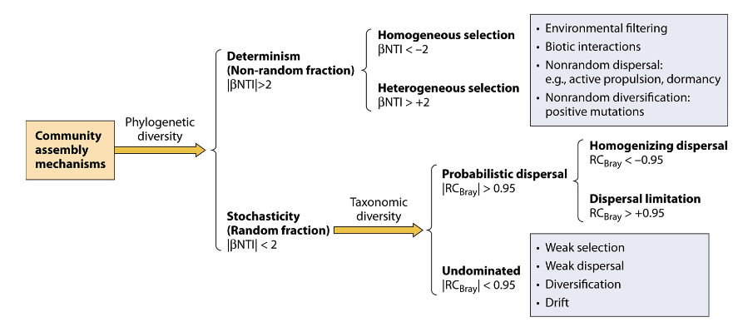
What does this modular structure tell us about the processes that shaped the network?
Stegen et. al., 2012; Zhou & Ning, 2017
Notes:
To answer my question we need first to connect between the structure and the processes.

Slide 18
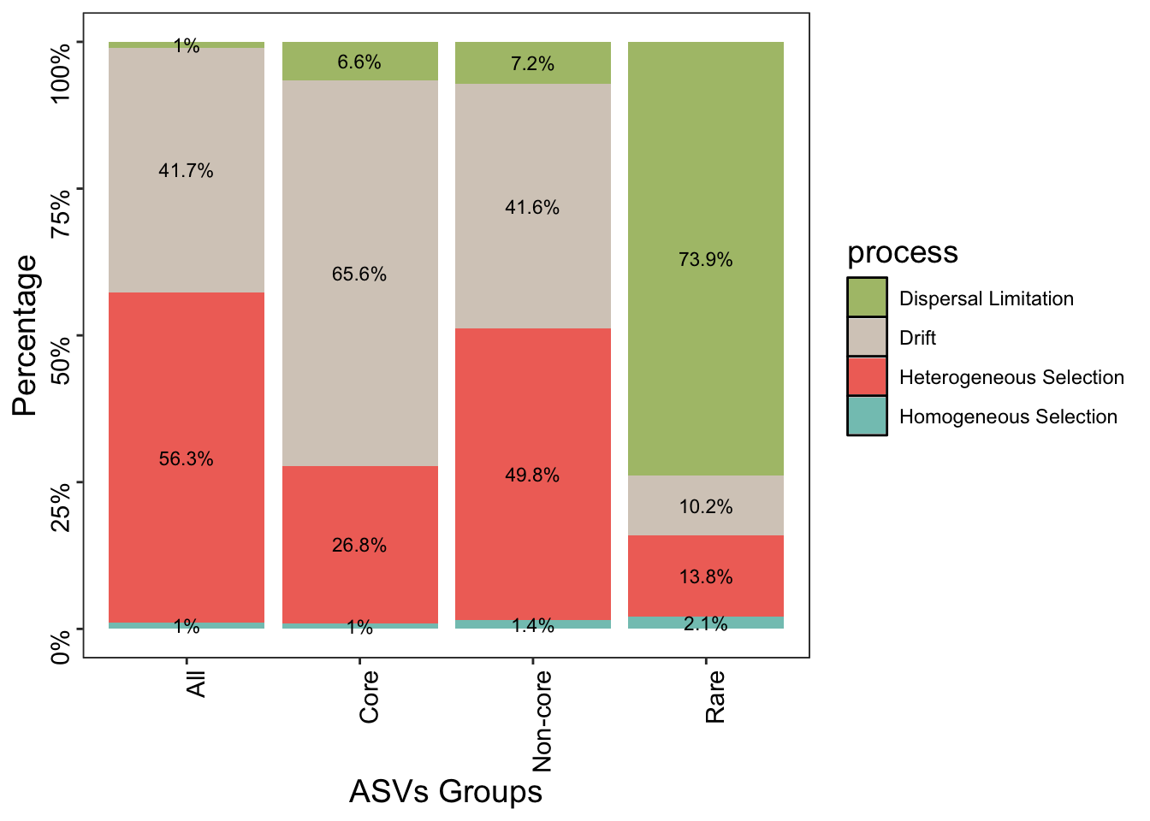
Distinct processes for prevalence groups

Slide 19
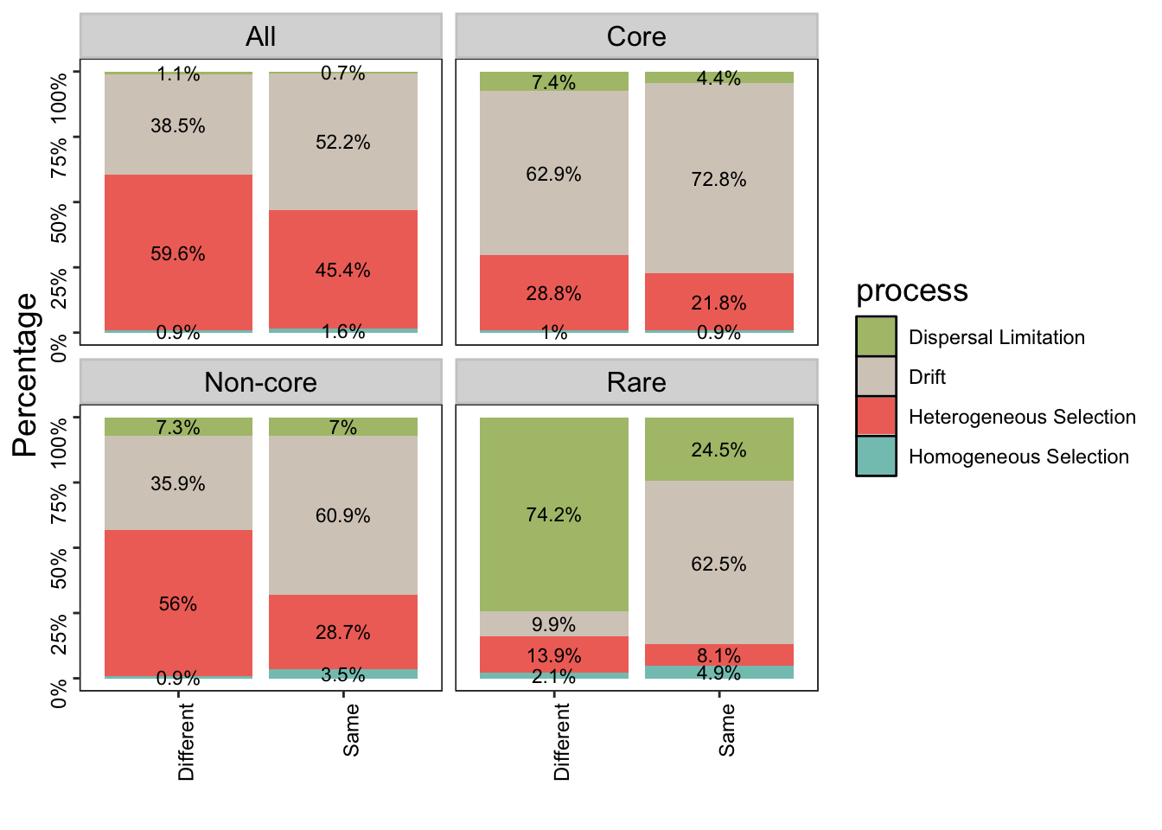
Network’s modules are indicative of the processes
Rare
The modules capture microbe turnover due to dispersal limitation between hosts
Neutral processes dominate the variation between hosts clustered in the same module

Slide 20
Network’s modules are indicative of the processes
Non-core
The modules capture selective differences between hosts
Neutral processes dominate the variation between hosts clustered in the same module

Slide 21
Network’s modules are indicative of the processes
Core
Neutral processes dominate the variation between hosts clustered in same and different modules

Slide 22
Q1. What processes shape host-microbe community structures along a land use change gradient?

Slide 23
Q1.2. How does the composition of modules vary across land use change gradient?
H2 + H3

Slide 24
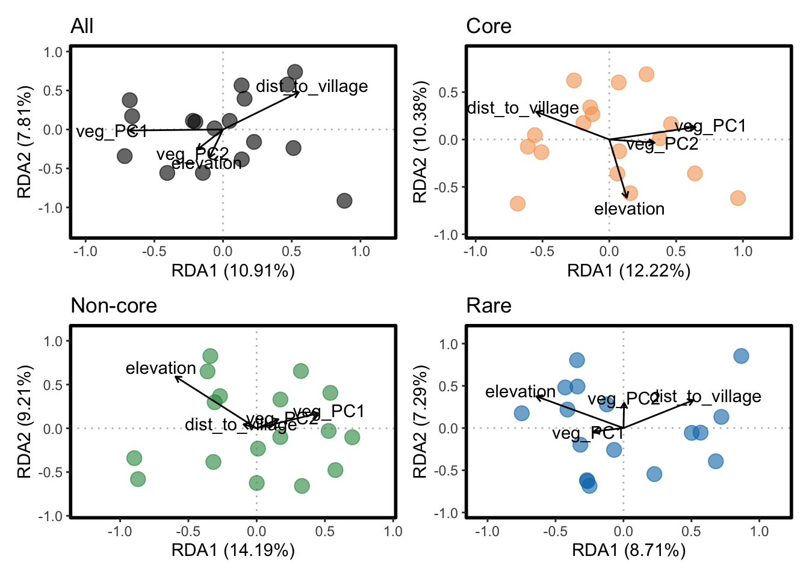
Environmental gradients explain modules variation for Non-core and Rare groups

Slide 25
Summary
Core microbes are more consistence across land use
Non-core and Rare microbes are gradually changed along land use change gradient - Non-core – selective process (environmental filtering) - Rare – dispersal limitation

